Slide 1
Misconceptions about software testing

Slide 2


About me
I started testing back in 2004
Joined on the 10th of October 2013
I work @

Slide 3







Why this talk?
Testing community
NO !!
THREE
FOUR
The magic book
Feedback
of
I am right
Gatherings
SOFTWARE TESTING
Blogs
We see things differently and fail to understand different perspectives
We live in bubbles

Slide 4
Why this talk?
Misconceptions effect
Make tester’s life harder
Work more difficult
Endless debates and discussions
Hinder our understanding of the testing craft
Promote illusions and wrong expectations about software testing
I found at least 23 of them

Slide 5
1. Everyone can test
12. It’s good & ok to test at the end of the Sprint
1.1 Tester’s salary should be less then a developer
12.1 Testing should be done after the de development is done
2. Testing can be done under any circumstances
13. Testing is what testers do.
2.1 Anything can be tested
13.1 Testing can be done in isolation by testers
3. Testing cannot be done without specifications
14. Testing is not a structured activity
3.1. Understanding requirements means reading them
3.2 Tests are executable specifications
14.1 Testing can find all the bugs
14.2 Production bug: testers have failed
4. Manual vs. automated testing
15. Testers just have to be smart.
5. Automated testing
16. Learning testing
16.1 Certifications are good or bad
16.2 I will test better next time
5.1 Test automation pyramid
6. Quality assurance is testing
17. Testers are unsuccessful developers
7. Testers have to find bugs.
17.1 Testers should not learn how to code
8. Testers break software
18. Testing is an analytical activity.
18.1 In order to properly test you need test cases
9. Testers with 5 years’ experience are senior.
19. Counting test cases/execution is a good thing
10. Don’t have enough time
20. What is software testing
11. Testers are the bearers of bad news.
21. I am a good tester

Slide 6


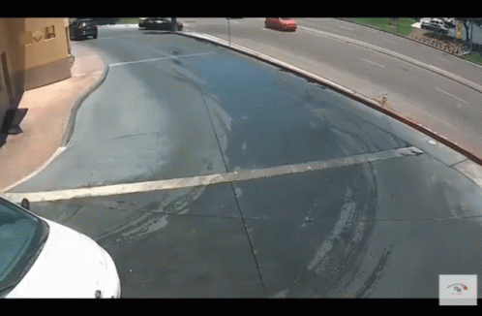

1. Everyone can test
1.1 Tester’s salary should be less then a developer
Saying that everyone can test is like saying everyone can drive

Slide 7
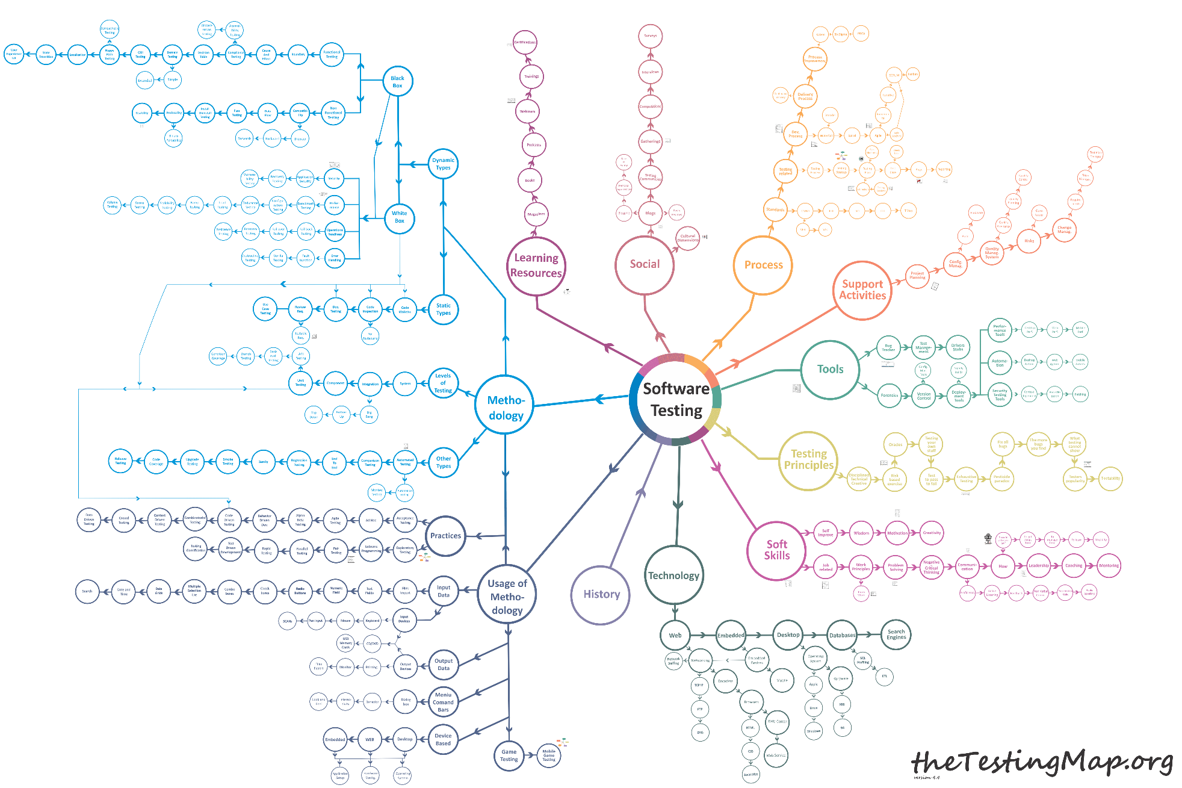
1. Everyone can test
TheTestingMap.org

Slide 8
1. Everyone can test
1.1 Tester’s salary should be less then a developer
Why does this happen?
testes are unable to properly explain what they are doing
could it be that testers do not manage to create a clear picture about what testing is within the project / company
could it be that testers do not highlight the value of their work

Slide 9
2. Testing can be done under any circumstances
2.1 Anything can be tested
testing
testability
Testability
is the measure
of how easily
a software system, component, or hypothesis
can be tested
to verify its correctness, reliability, and functionality.

Slide 10
2. Testing can be done under any circumstances
2.1 Anything can be tested
testing
testability
Testability is a team’s approach
It should not be an accident but a conscious decision
Testability is the root cause of many production bugs, and a lot of time is spent reproducing them
Notes:
Before we move on to the next misconception a few words about testability.
Testability is a team’s approach
It should not be a accident but a conscious decision
Testability is the root cause of many production bugs and a lot of time is spent reproducing them.
What do you think is the worst bug? A production bug? Well I believe that the worst bug is a production but that you cannot reproduce.

Slide 11
3. Testing cannot be done without specifications
The outcome can be determined by the
Nature of the product
Tester’s knowledge of the domain
The skills and professionalism of the tester
The availability of required resources
By the approach you take: exploratory testing
simultaneous learning, test design and test execution

Slide 12
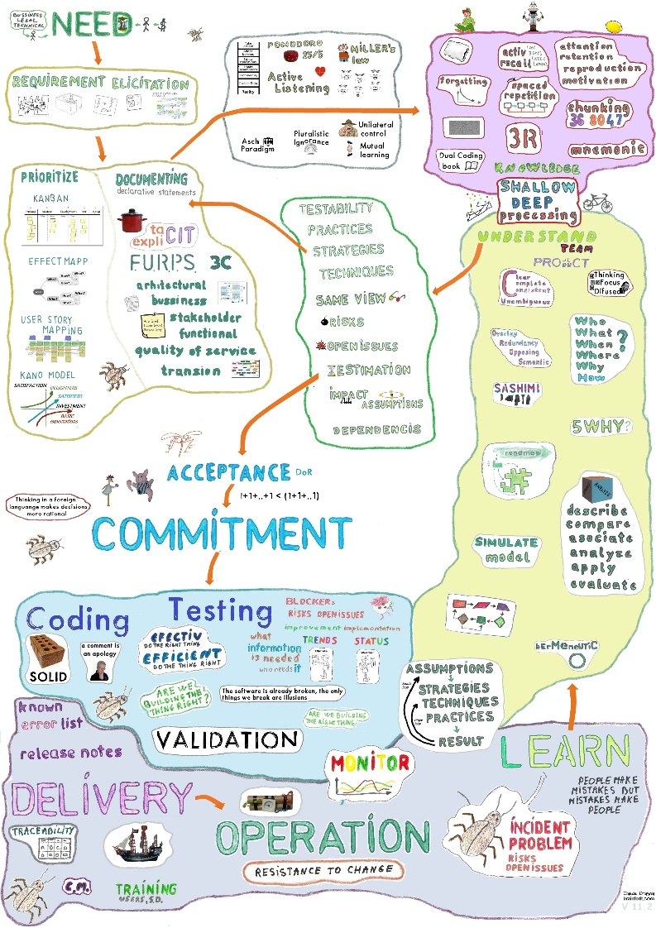
3.1. Understanding requirements means reading them
Critical Thinking Questions
Sashimi
Simulate and Model
Cubin
Drawing Diagrams and Flows
reviewrequirements.brainforit.com

Slide 13
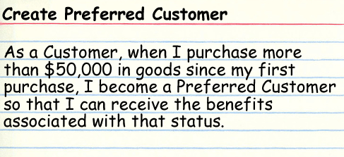
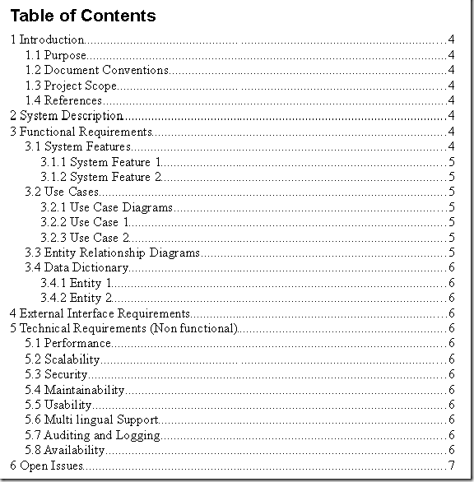
3.2 Tests are executable specifications
Positive tests
Scenarios
+
Valuable information
DoD
Negative
Security
Performance
Test Claims

Slide 14


4. Manual vs. automated testing

Slide 15
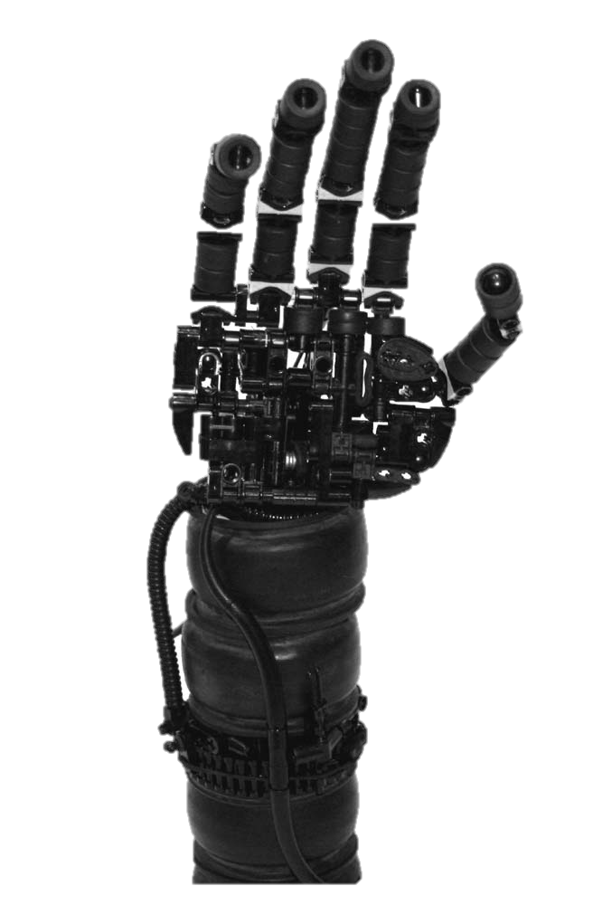
4. Manual vs. automated testing

Slide 16

4. Manual vs. automated testing

Slide 17
5. Automated testing
automation
1. Do a test
Not everything / only specific checks
2. Decide to automate it
3. Use a toll to automate the execution
all checks have to be specified
no other check is done beside the specified ones
4. Debugging in case of failure
5. You update or remove it

Slide 18



5. Automated testing
automation
Cost of testing
Number /
importance of defect
Under test
Over test
time

Slide 19
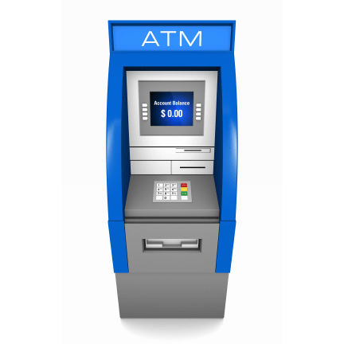
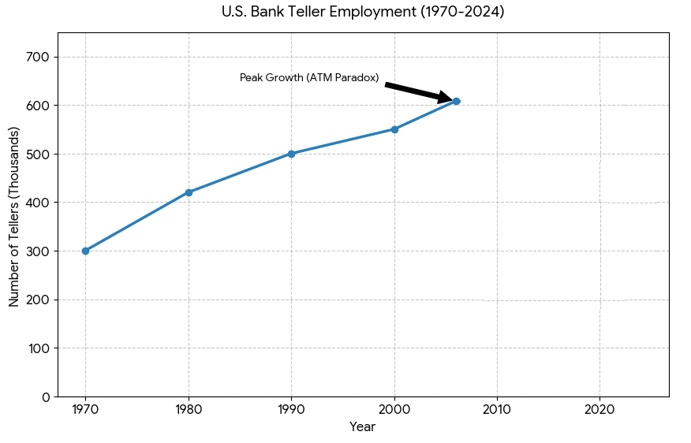
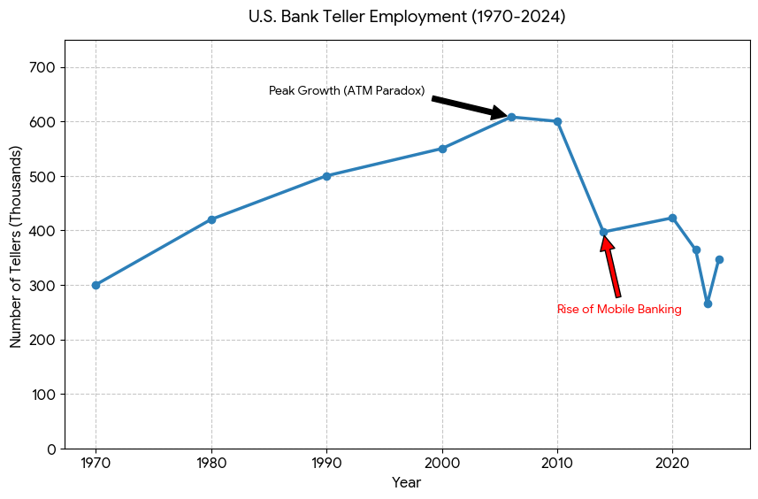
5. Automated testing
automation

Slide 20
5.1 Test automation pyramid
Debugging time
GUI
Coverage
Mockups
Fragility
System
Requires build
and deploy
Maintenance
Integration
Duration
Component
On local machine
after change
Cost
Unit
brainforit.com

Slide 21
5.1 Test automation pyramid
GUI
Debugging time
System
Coverage
Integration
Fragility
Component
Maintenance
Duration
Unit
Cost

Slide 22
6. Quality assurance is testing
Quality Management System
Process improvement
Establish
processes & standards
Quality
Planning
Doing
Final Product
Quality Assurance
Tailor
processes & standards
based on context
Testing
How you want to do it?
How will you use it?
Check usage of processes
Check usage of processes and product
Check the product
Quality Control
Are we using it?

Slide 23



7. Testers have to find bugs.
Testers should be like the headlights of a car
Make predictions
The driver can adjust the speed.
Change directions
Provide information about the current status

Slide 24
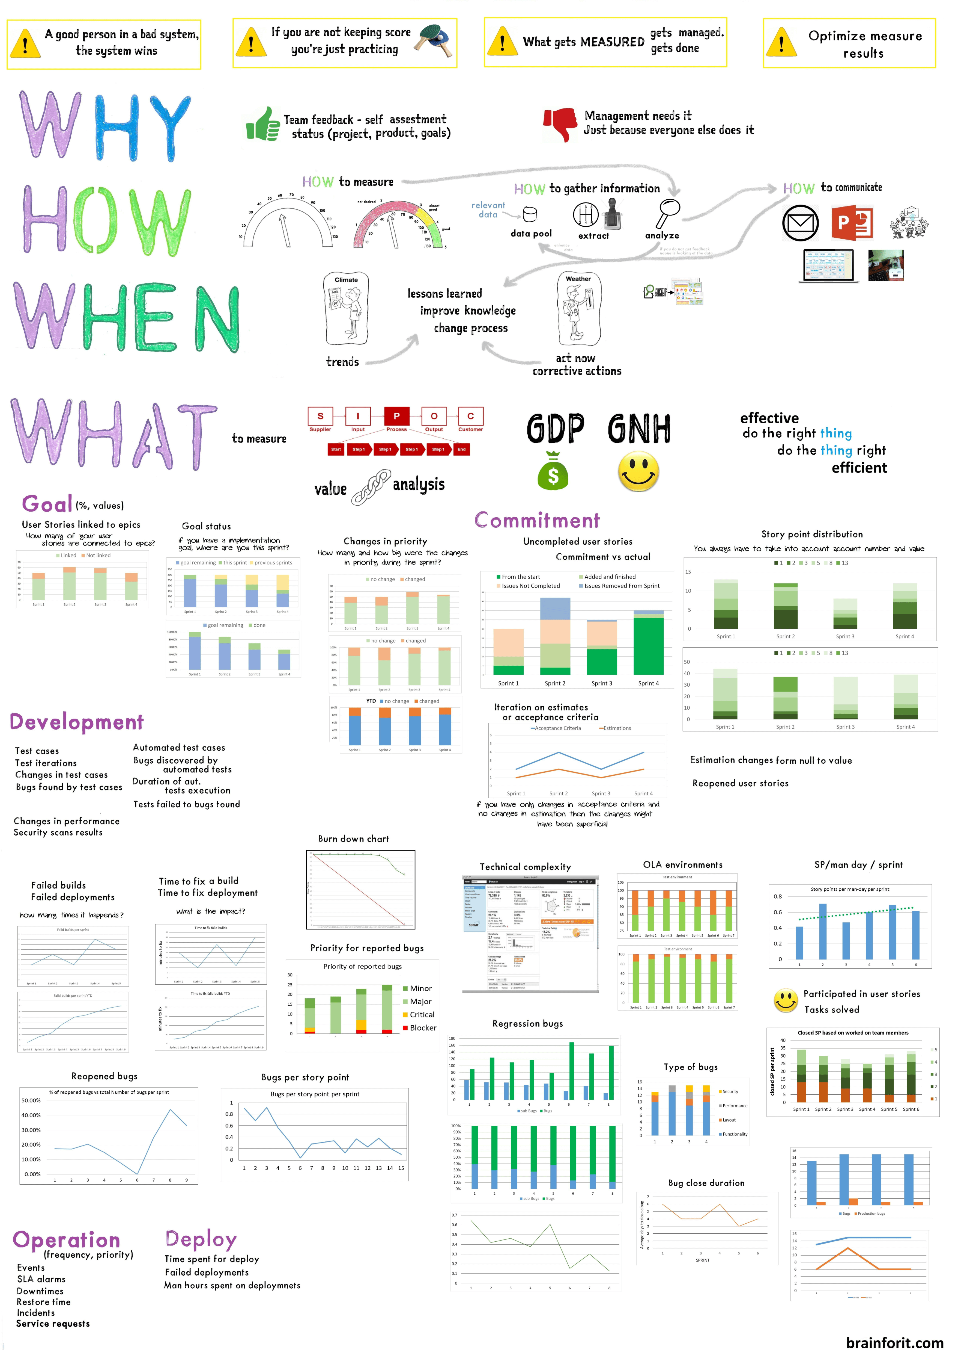
7. Testers have to find bugs.
Testers should be like the headlights of a car
But what to measure?

Slide 25
8. Testers break software
Michael Bolton beautifully said it “testers do not break software, the software is already broken”.
Testers break illusions by providing relevant information.

Slide 26
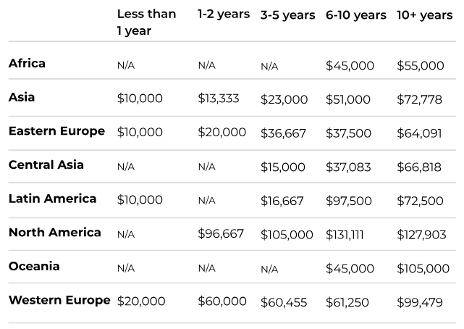

9. Testers with 5 years’ experience are senior.
Increase salary

Slide 27
9. Testers with 5 years’ experience are senior.
you do something
you do it again
you do it again
you do it again
you do it again
you get hired
2013
today
2018
Can you succeed in any other project, team, technology ?

Slide 28




10. Don’t have enough time
You have 2 hours to test everything !!!!
GO GO GO GO
I have to work more
This is what I have to test <….>
This is <…> how much time it takes,
What should I do in 2 hours?

Slide 29


11. Testers are the bearers of bad news.
Nothing works
Worst build ever
2clicks and it all crashed
Half implemented
Lost my time waiting for this
we are not done
YET
this is what I believe we should do

Slide 30
12. It’s good & ok to test at the end of the Sprint
12.1 Testing should be done after the de development is done (testers are gatekeepers)
Scrum guide :
7th principle from the Manifesto for agile software development:
“Scrum Teams deliver products iteratively and incrementally, maximizing opportunities for feedback”.
“Agile processes promote sustainable development. The sponsors, developers, and users should be able to maintain a constant pace indefinitely.”.

Slide 31
13. Testing is what testers do.
13.1 Testing can be done in isolation by testers
Testing is an activity.

Slide 32
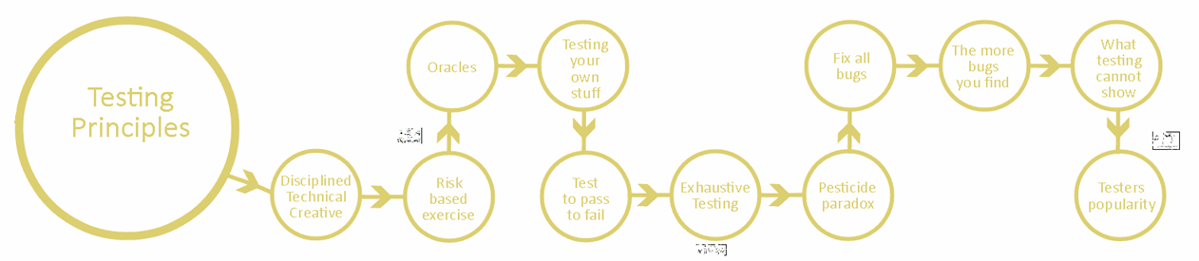
14 Testing is not a structured activity

Slide 33
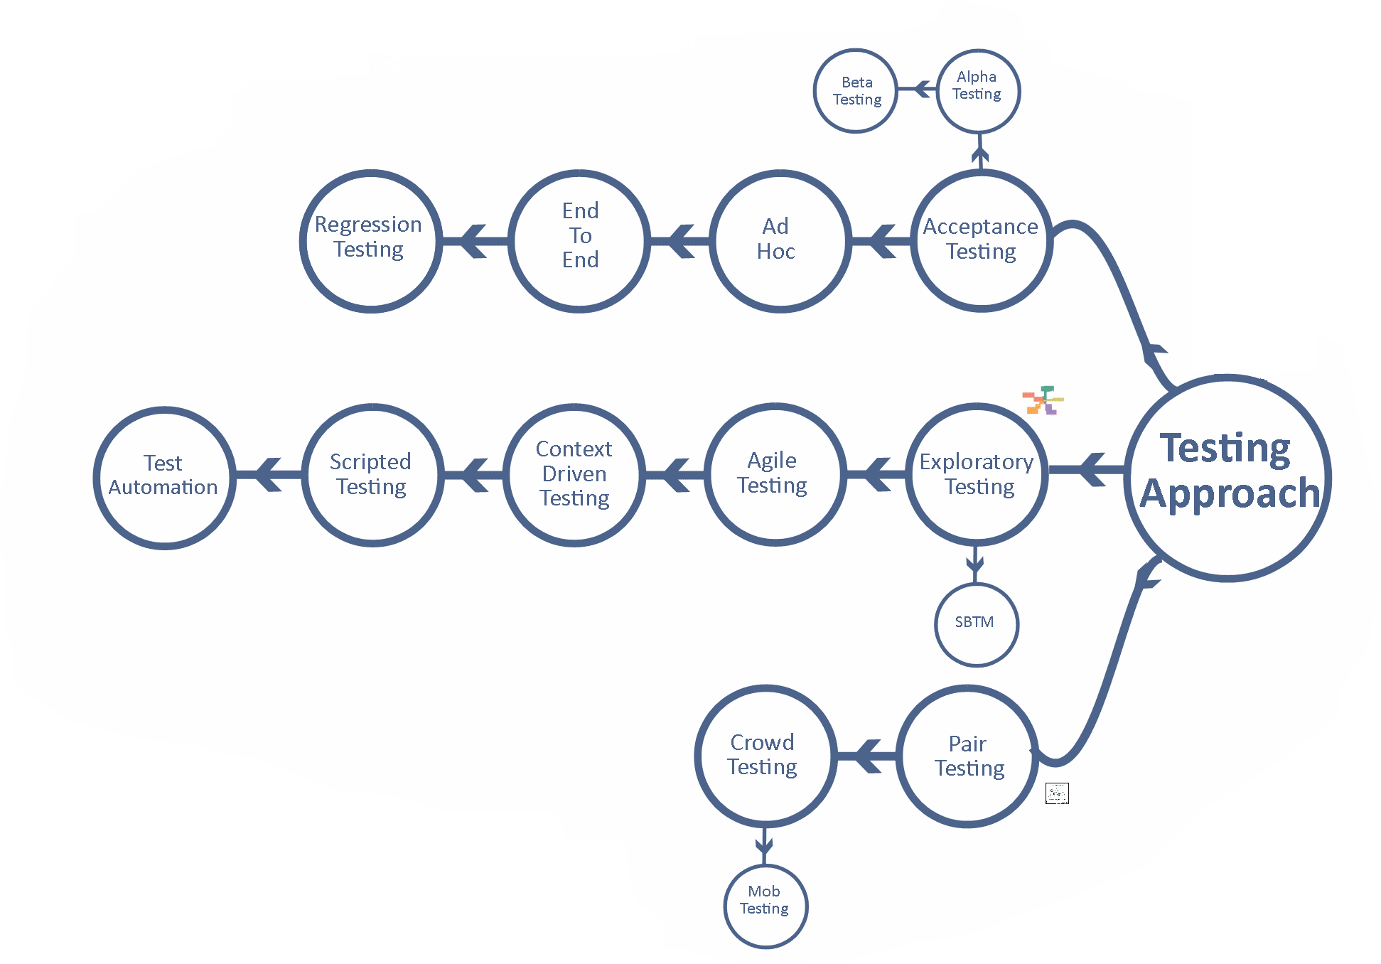
14 Testing is not a structured activity

Slide 34
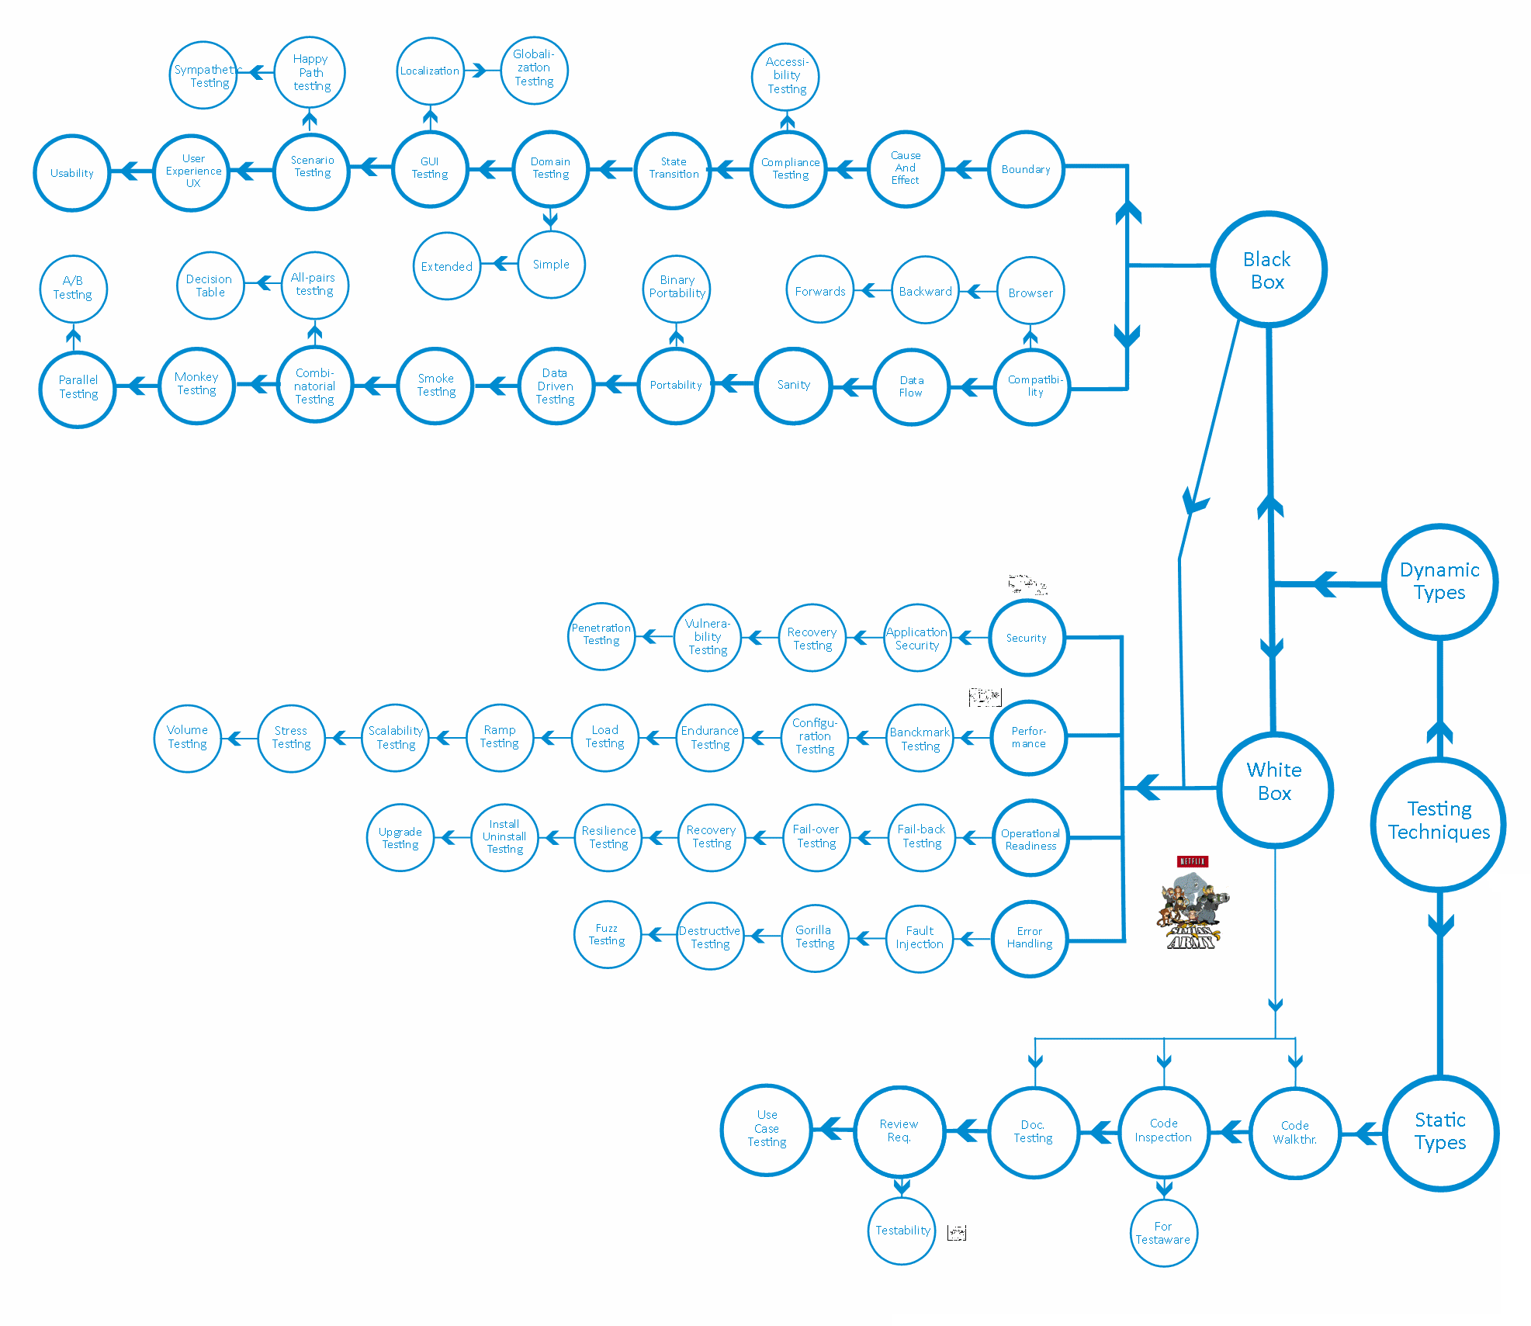
14 Testing is not a structured activity

Slide 35

14.1 Testing can find all the bugs
It depends on your GOAL !!!
testing requires people + resources + time

Slide 36
14.2 Production bug: testers have failed
It depends on your GOAL !!!
Did you had all you needed?
(and asked for it in advance)

Slide 37

20. I am a good tester
14. Testers just have to be smart
It is never enough just to be smart
Know your testing techniques and approaches
Grow your mindset and you leave your project

Slide 38
15.1 Certifications are good or bad
This is testing
Create a system that can evaluate your skills and knowledge
+ a evaluation method

Slide 39
15.2 I will test better next time
Strategies
Techniques
Practices
Result

Slide 40
15.2 I will test better next time
Assumptions
Strategies
Techniques
Practices
Result

Slide 41
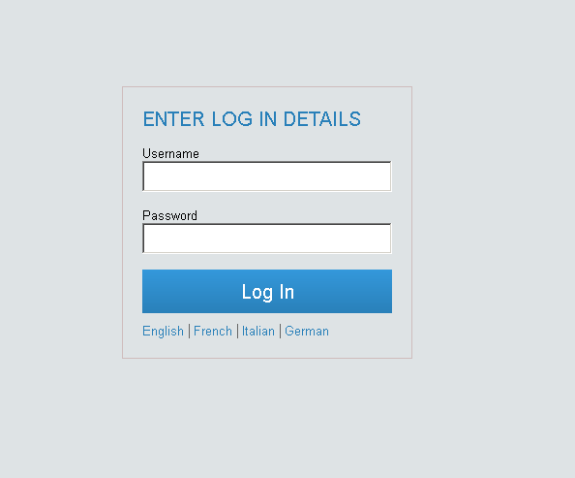
18. Testing is an analytical activity.
Testing Challenge #10 - BUG HUNT
10
11
12
13
14
15
16
17
18
20
21
1
2
3
4
5
6
7
8
9
Bugs

Slide 42
18.1 In order to properly test you need test cases
Test Case
Preconditions
Steps
Action
Data
Expected results
Post conditions
testability
Purpose of documentation
Review
Validation
Execution tracking
Reusability
Evidence of activity
Execution by anyone

Slide 43

19. What is software testing
(g,r,f,c,d,t,p) = testing
goals
resources
functionality
configuration
data
time
people (knowledge, skills, interactions)
ksi
+testability

Slide 44

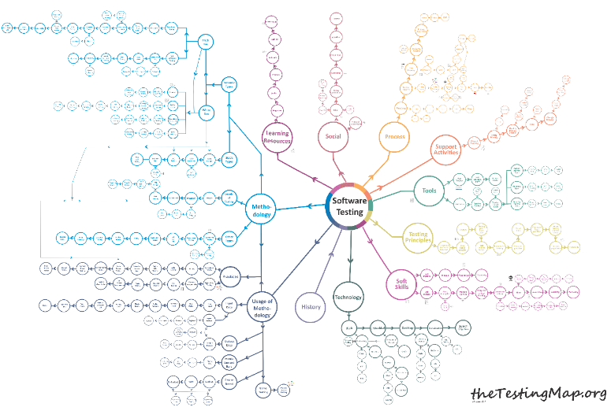

17. Testers are unsuccessful developers
Logic
Logic
Critical Thinking
Critical Thinking
Habits
Creativity
Habits
Creativity
Intuition
System 1
Intuition
System 2
System 1
Social skills
System 2
Social skills
Growth mindset
Growth mindset
Experience
Experience
Developer
Tester

Slide 45
15. Learning testing
15.1 Certifications are good or bad
15.2 I will test better next time
science
knowledge
time

Slide 46

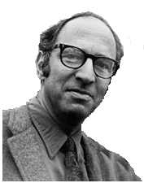
15. Learning testing
15.1 Certifications are good or bad
15.2 I will test better next time
Normal
science
Paradigm
Change
Model Drift
Model Revolution
Model Crisis
Thomas Khun

Slide 47
1. Everyone can test
12. It’s good & ok to test at the end of the Sprint
1.1 Tester’s salary should be less then a developer
12.1 Testing should be done after the de development is done
2. Testing can be done under any circumstances
13. Testing is what testers do.
2.1 Anything can be tested
13.1 Testing can be done in isolation by testers
3. Testing cannot be done without specifications
14. Testing is not a structured activity
3.1. Understanding requirements means reading them
3.2 Tests are executable specifications
14.1 Testing can find all the bugs
14.2 Production bug: testers have failed
4. Manual vs. automated testing
15. Testers just have to be smart.
5. Automated testing
16. Learning testing
16.1 Certifications are good or bad
16.2 I will test better next time
5.1 Test automation pyramid
6. Quality assurance is testing
17. Testers are unsuccessful developers
7. Testers have to find bugs.
17.1 Testers should not learn how to code
8. Testers break software
18. Testing is an analytical activity.
18.1 In order to properly test you need test cases
9. Testers with 5 years’ experience are senior.
19. Counting test cases/execution is a good thing
10. Don’t have enough time
20. What is software testing
11. Testers are the bearers of bad news.
21. I am a good tester

